Slide 1


Smart Asset Tracking and Predictive Maintenance System for Flight Catering
Project ID : 20
Internal Advisor ~ Dr Shahab Tehzeeb

Slide 2
GROUP MEMBERS
WAHAJ RAZA
CS – 21055
CGPA : 3.96
FARRUKH NIAZ
CS – 21064
CGPA : 3.2
HUZAIFA NASEER
CS – 21067
CGPA : 3.37
MUZAMMIL RIZVI
CS – 21089
CGPA : 3.4

Slide 3
Project Introduction
Designed for flight catering vehicle fleets operating in high-pressure airport environments.
Addresses challenges like unexpected breakdowns, high maintenance costs, and lack of real-time visibility.
Utilizes IoT sensors (GPS, TPMS, temperature) for continuous monitoring.
Employs AI/ML (Bi-LSTM) models for predictive maintenance to reduce downtime.
Integrated with Swift Platform for real-time dashboards and Salesforce ERP for automated ticketing.
Aims to deliver operational efficiency, cost savings, and proactive maintenance workflows.

Slide 4
Problem Statement
Unplanned Vehicle Downtime
Leads to service delays and potential flight disruptions due to reactive maintenance.
High Maintenance Costs
Emergency repairs and time-based servicing increase operational expenses.
Lack of Real-Time Asset Visibility
No continuous monitoring of vehicle location, tyre pressure, or engine health.
Inefficient Maintenance Workflows
Manual fault reporting and disjointed systems delay issue resolution.
Suboptimal Resource Utilization
Poor scheduling of maintenance staff and vehicle usage.
Potential Safety Hazards
Missed early warnings like low tyre pressure or engine overheating can risk personnel.

Slide 5
PHASE 1
PHASE 2
PHASE 3
Overall
Architecture
Design
Solution Integration
UI / UX
Prototype
Sensor Data Simulation
Device Connectivity
Testing
Interface Creation of Swift
ML Predictive
Model
Demo
Launch
Real Time Dashboard Dataflow &
Alerts Generation

Slide 6
GANTT CHART

Slide 7
Milestones Achieved Summary
Swift Platform Setup & IoT Sensor Research
Swift App Design & Real-Time Dashboard Development
Sensor Data Simulation & Anomaly Alert System
Hardware Integration with ESP32 & Sensors
Bi-LSTM Model Training for Predictive Maintenance
ERP (Salesforce) Integration for Auto-Ticketing
Full System Integration & Validation
Final Report, Demo & Launch Preparation

Slide 8
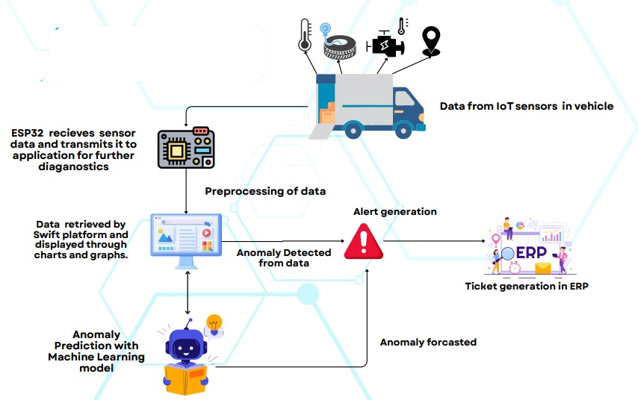

FLOW OF THE PROJECT

Slide 9
FLOW OF THE PROJECT

Slide 10
FLOW OF THE PROJECT

Slide 11
FLOW OF THE PROJECT

Slide 12

FLOW OF THE PROJECT

Slide 13
FLOW OF THE PROJECT

Slide 14
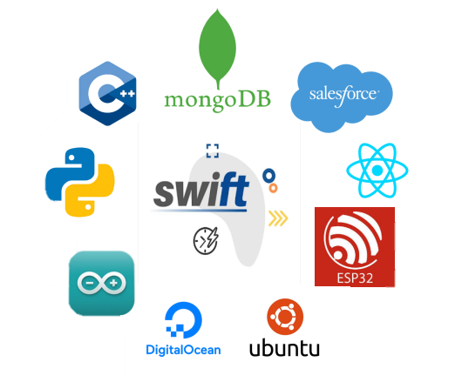
Tools Used

Slide 15
Hardware Design & Sensor Integration
Microcontroller:
ESP32-S3 with dual-core processing, Wi-Fi/BLE, and GPIO support for real-time embedded control.
Sensors Integrated:
NEO-6M GPS – Location & speed tracking
DS18B20 – Engine temperature monitoring
BLE TPMS – Tyre pressure & temperature sensing
Custom PCB:
Designed for compact integration, enclosed in IP-65 casing for durability in harsh environments.
Firmware Highlights:
Sensor data acquisition & alert logic
Wireless data transmission via JSON APIs
Power Supply:
Supports 12V/24V systems with regulated 3.3V/5V output.
Key Features:
Cost-effective, scalable, and rugged — ideal for fleet-wide airport deployments.

Slide 16
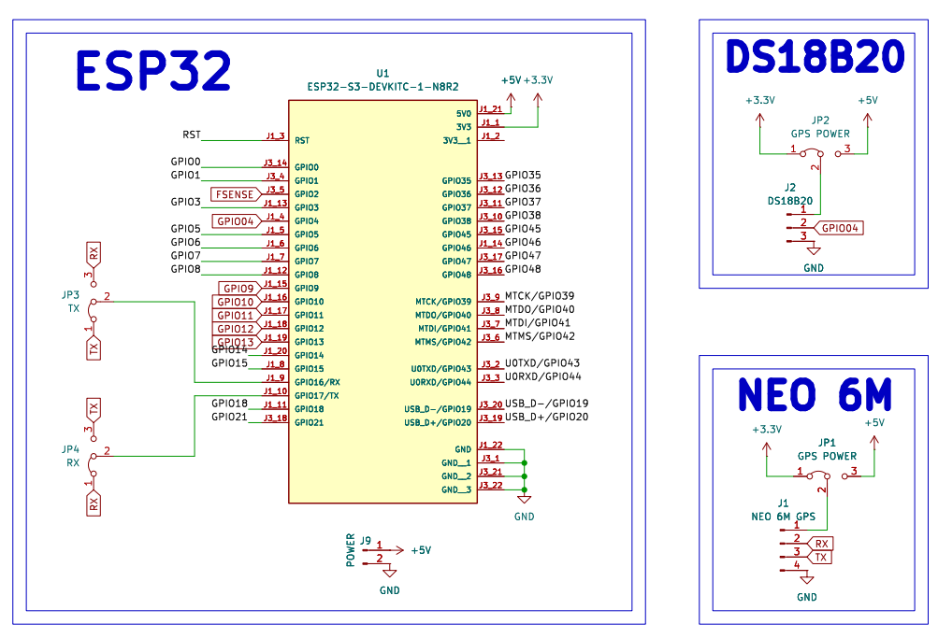
Hardware Design & Sensor Integration

Slide 17
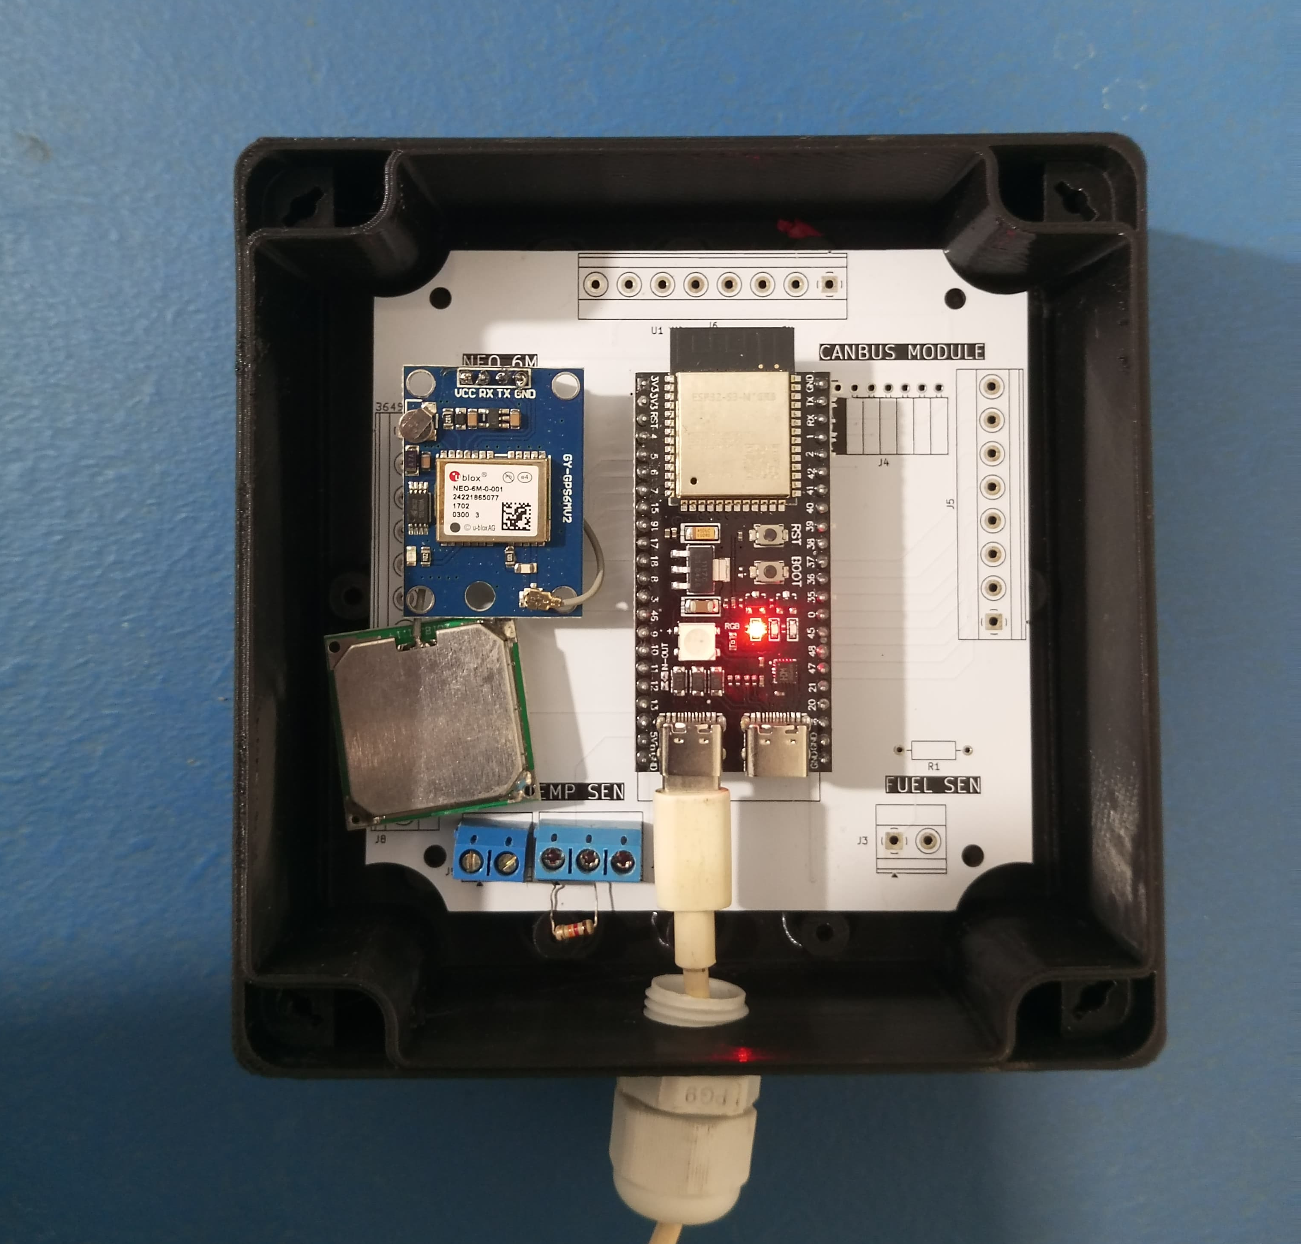
Hardware Design & Sensor Integration

Slide 18
Predictive Maintenance – AI/ML Model Design
Overview:
We implemented a Bidirectional LSTM (Bi-LSTM) model for forecasting vehicle health metrics.
Model Input:
Time-series data from sensors (Engine Temp, Tyre Pressure, Tyre Temp)
Features used:
  24-hour lag values
  72-hour rolling averages
  Cyclical encodings (hour, day, month)
Training Approach:
Trained on historical data from industry for one year period
Validated with synthetic 2025 data for robustness
Performance Metric:
Achieved Mean Absolute Error (MAE) of:
  0.1795°C for Engine Temperature
  0.2368 MPa for Tyre Pressure

Slide 19
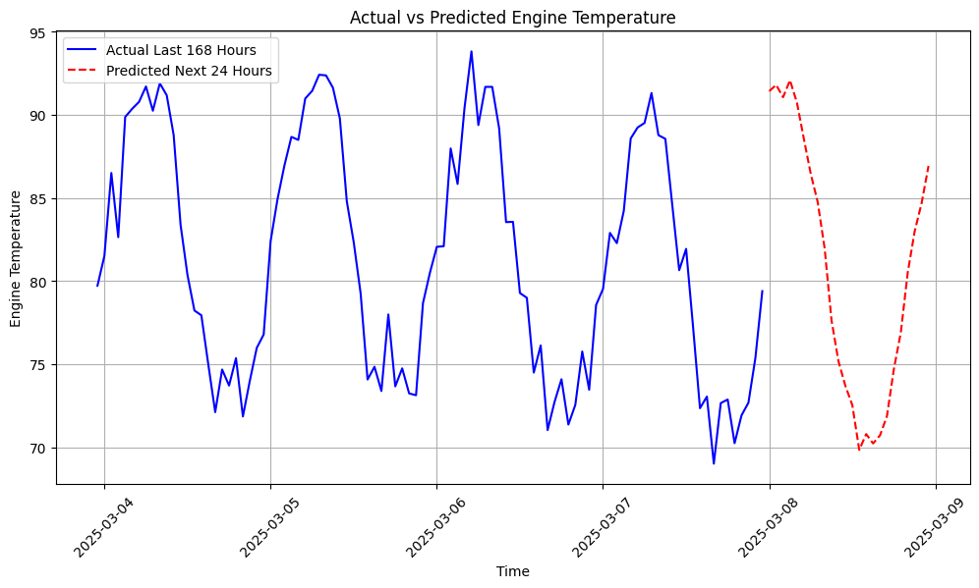
Predictive Maintenance – AI/ML Model Design
LSTM - MODEL

Slide 20
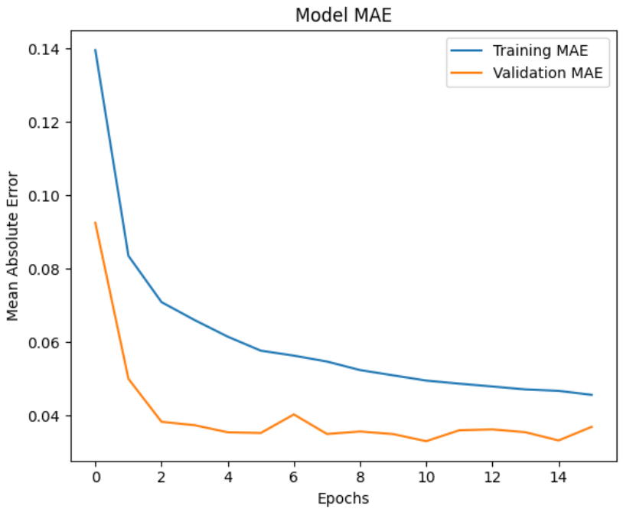
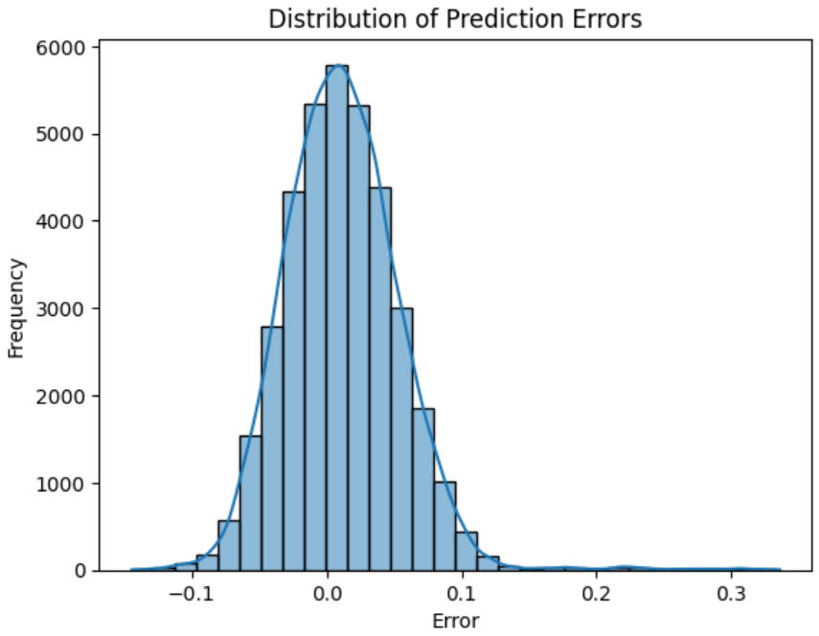
Predictive Maintenance – AI/ML Model Design
LSTM - MODEL

Slide 21
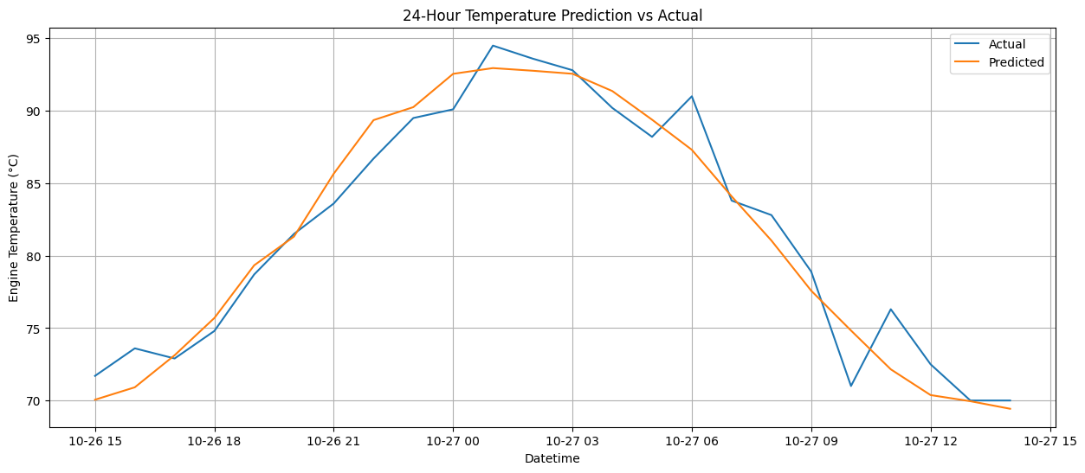
Predictive Maintenance – AI/ML Model Design
LSTM - MODEL

Slide 22
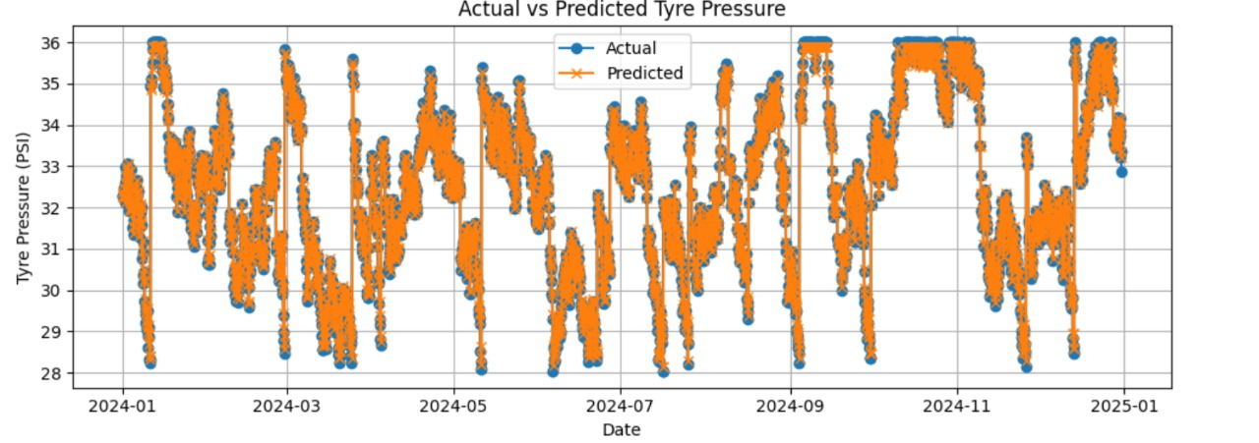
Predictive Maintenance – AI/ML Model Design
ARIMA

Slide 23
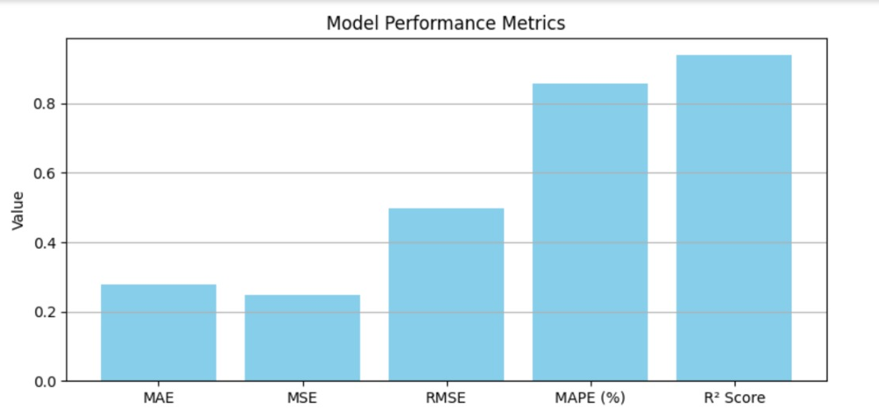
Predictive Maintenance – AI/ML Model Design
ARIMA

Slide 24
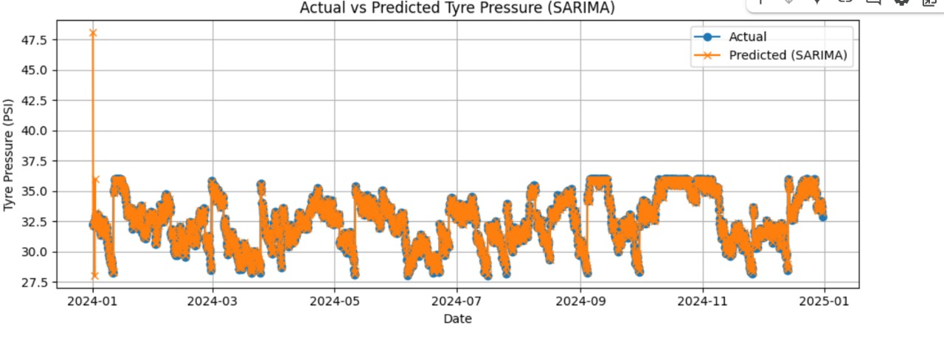
Predictive Maintenance – AI/ML Model Design
SARIMA

Slide 25
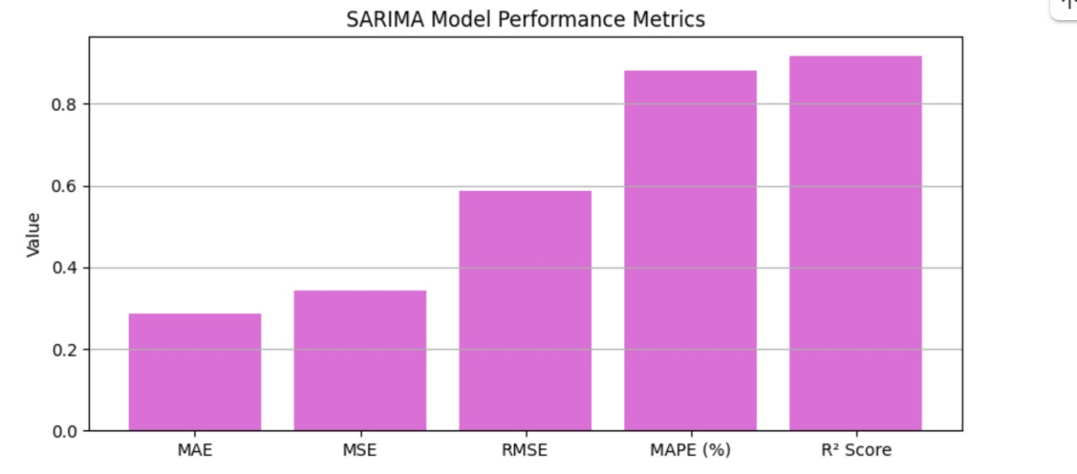
Predictive Maintenance – AI/ML Model Design
SARIMA

Slide 26
ERP Integration with Salesforce
Real-Time Data Sync with Swift ERP
Key Points:
Integration Type: Outbound Webhook from Swift to Salesforce
Authentication: OAuth 2.0 used for secure communication
Webhook Functionality:
- Swift sends fleet status updates & alerts to Salesforce
- Webhook endpoint built in Swift Workflow.
Data Handling:
- Incoming data is parsed and mapped to custom Salesforce objects
- Custom objects used: Fleet_Status__c, Fleet_Alert__c
Business Impact:
- Real-time visibility of fleet conditions
- Enables preventive actions within Salesforce

Slide 27
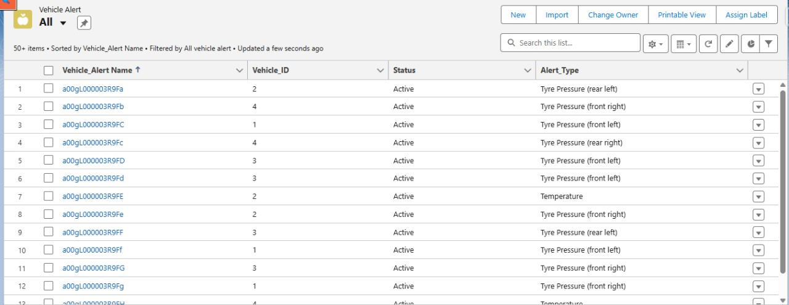
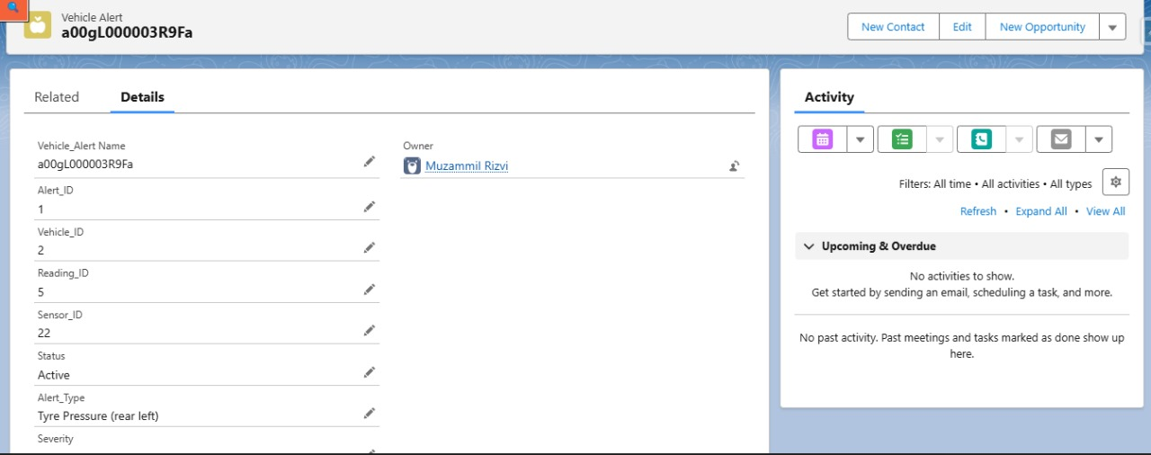
Predictive Maintenance – AI/ML Model Design

Slide 28
Alert Generation & Anomaly Detection
Intelligent Alerting and Feedback Loop
Key Points:
Alert Handling Logic in Salesforce:
- On receiving data from Swift, system checks fleet status
- If Status = Critical, assign mechanic a task of critical Fleet.
Mechanic Action Workflow:
- Mechanic updates vehicle status post-repair (e.g., Critical → Operational)
- Status change stored in Fleet_Status__c object
Sync Back to Swift:
- Salesforce pushes updated status to Swift via outbound callout
- Maintains data consistency across both systems
Business Value:
- Reduces downtime through fast response
- Ensures Swift ERP stays updated with latest maintenance actions

Slide 29
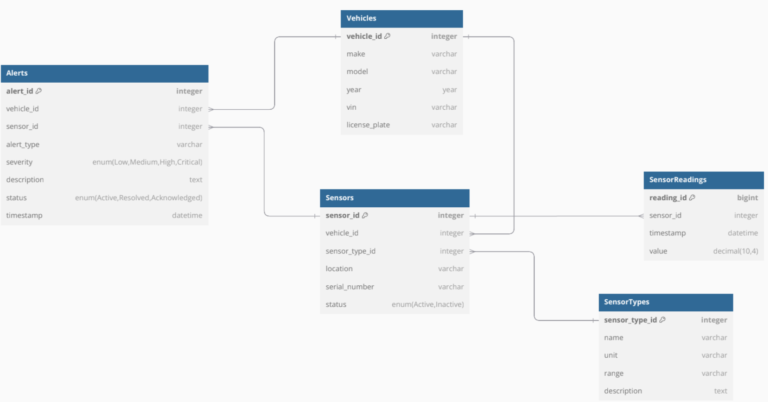
ER DIAGRAM

Slide 30
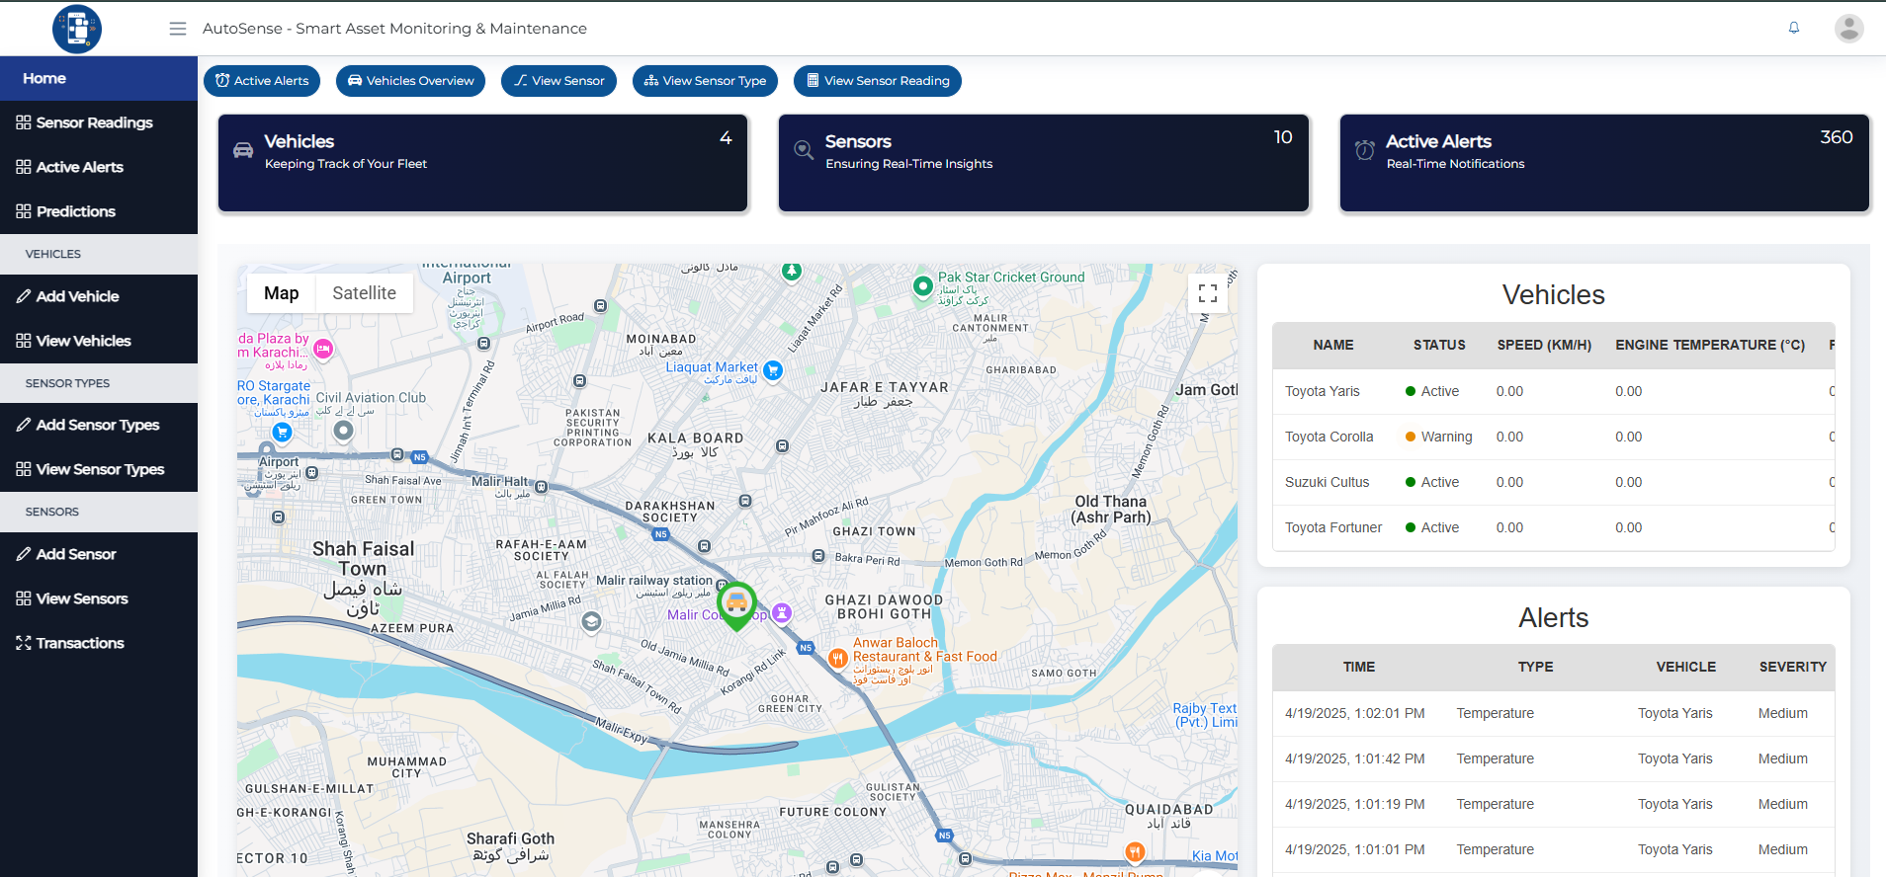

Slide 31
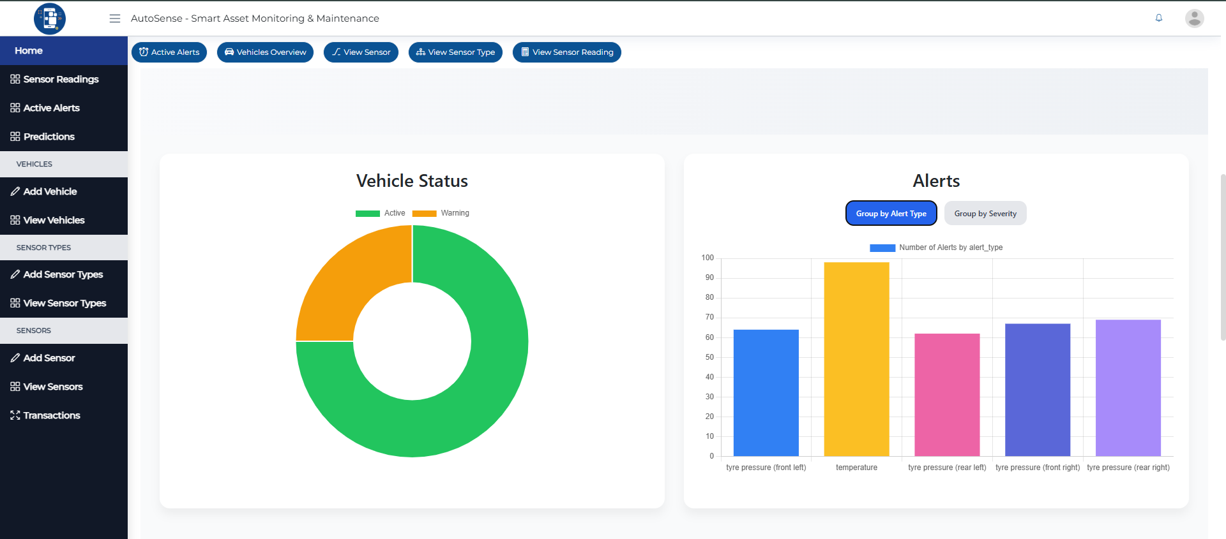

Slide 32
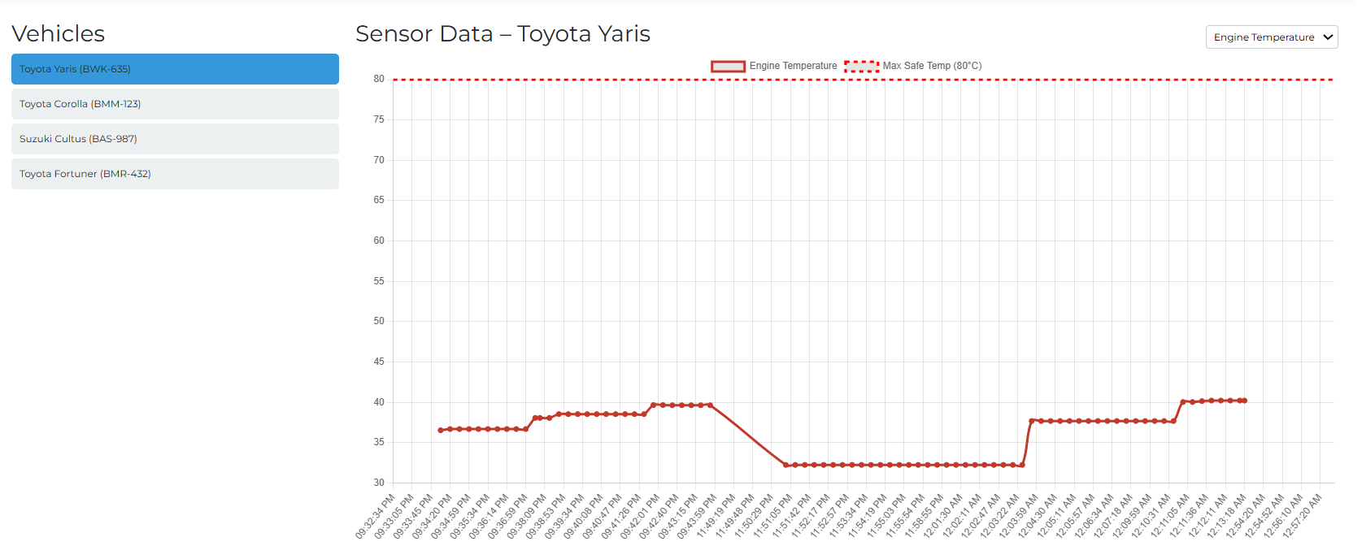

Slide 33
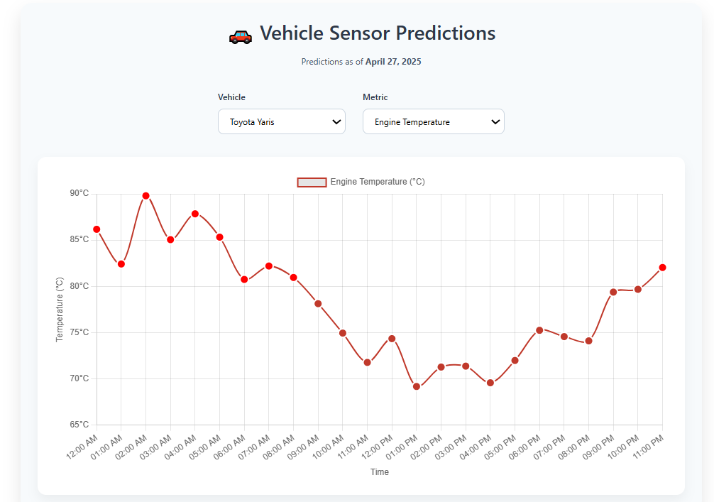

Slide 34
Future Enhancements
Fleet-Wide Deployment
Scale the system for real-world deployment across an entire catering vehicle fleet.
Sensor Expansion
Integrate additional sensors (e.g., fuel flow, brake wear, humidity) for deeper diagnostics.
Edge AI Integration
Run basic anomaly detection models directly on the ESP32 for faster response without cloud dependency.
Dynamic Route Optimization
Use real-time vehicle health + traffic data to reroute vehicles safely and efficiently.

Slide 35
INDIVIDUAL’S CONTRIBUTION IN ACHIEVING MILESTONES
WAHAJ RAZA
CS – 21055
Real Time Dashboard Graphs
Alerts & notification system (Swift App)
ML Model RnD & Training
Deployment Ready ML Model Pipeline Development
Database Schema Definition
Webhooks for alerts & notifications
Middleware-DB-frontend integration
HUZAIFA NASEER KHAN
CS – 21067
Readings and Alerts table on dashboard
Google Maps integration for real-time location monitoring
Mock sensor data simulation for testing
ESP32 Firmware development
Sensors integration with microcontroller
Hardware assembly

Slide 36
INDIVIDUAL’S CONTRIBUTION IN ACHIEVING MILESTONES
FARRUKH NIAZ
CS – 21064
Research for sensors and ML models
Widget for alerts/notifications
Ensure accurate data forwarding
Project flow/timeline diagrams
View & Entry forms
Input validation mechanisms
Documentation & Research
MUZAMMIL RIZVI
CS – 21089
Sensor data integration into DB
Webhooks for Real-Time updates
Salesforce Integration
Tickets and alert generation logic
Sync Swift with Salesforce
ML Model RnD & Training
ML Model Deployments

Slide 37
THANK YOU!
Any questions?

